Slide 1
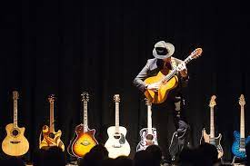

Childhood Dream

Slide 2
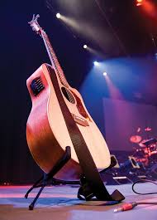
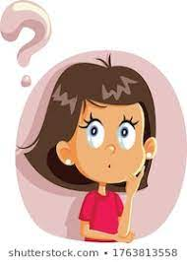
Admired people playing guitar.

Slide 3
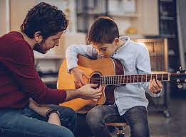
Presently learning guitar.

Slide 4
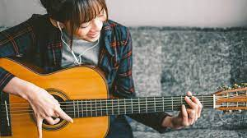
Spend most of the time learning and pracitising it my new time pass or rather I would say I’ve found the best way to use time admist lockdown.

Slide 5

Having Great Fun.

